Slide 1
C++
Md. Abdur Rahman
Senior Computer Scientist
Centre for Advanced in Research in Sciences (CARS)
University of Dhaka

Slide 2
Operator Overloading
It is a type of polymorphism in which an operator is overloaded to give user defined meaning to it.
Overloaded operator is used to perform operation on user-defined data type.
For example '+' operator can be overloaded to perform addition on various data types, like for Integer, String(concatenation) etc.

Slide 3
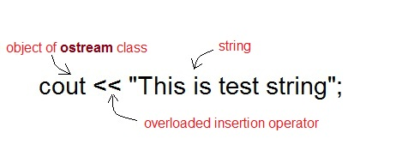
Operator Overloading

Slide 4
Operator Overloading
Almost any operator can be overloaded in C++. However there are few operator which can not be overloaded. Operator that are not overloaded are follows:
scope operator ::
sizeof
member selector .
member pointer selector *
ternary operator ?

Slide 5
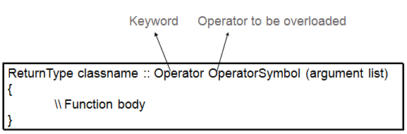
Operator Overloading Syntax

Slide 6
Implementing Operator Overloading
Operator overloading can be done by implementing a function which can be :
Member Function
Non-Member Function
Friend Function
Operator overloading function can be a member function if the Left operand is an Object of that class, but if the Left operand is different, then Operator overloading function must be a non-member function.
Operator overloading function can be made friend function if it needs access to the private and protected members of class.

Slide 7
Restrictions on Operator Overloading
Following are some restrictions:
Precedence and Associativity of an operator cannot be changed.
Arity (numbers of Operands) cannot be changed. Unary operator remains unary, binary remains binary etc.
No new operators can be created, only existing operators can be overloaded.
Cannot redefine the meaning of a procedure. You cannot change how integers are added.

Slide 8
Overloading Arithmetic Operator
Almost all arithmetic operator can be overloaded to perform arithmetic operation on user-defined data type. In the example we have overridden the + operator, to add to Time(hh:mm:ss) objects.
Example-1

Slide 9
Overloading Relational operator
Relational operator like ==, !=, >=, <= etc can be overlaoded to compare two user-defined object.
Example-2

Slide 10
Friend Function
A friend function of a class is defined outside that class' scope but it has the right to access all private and protected members of the class.
Even though the prototypes for friend functions appear in the class definition, friends are not member functions.
Example-3

Slide 11
Overloading operators using friend functions
Example-4

